Slide 1
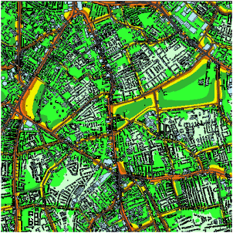
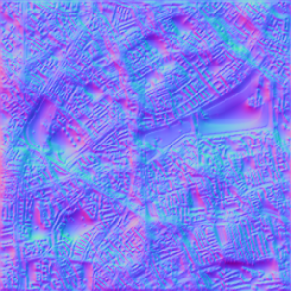
Noise Map – Grid map of a city

Slide 2
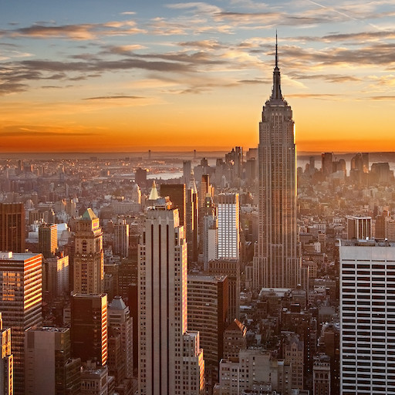
Landscape (Color map)

Slide 3
Goal
Emphasize the sunset with some yellow specular light
Maintain detail of the Noise map
Try and have roads and buildings visible in the distorted image
Maintain the general landscape of the original image
Preserve the skyscrapers, sunset, etc.

Slide 4
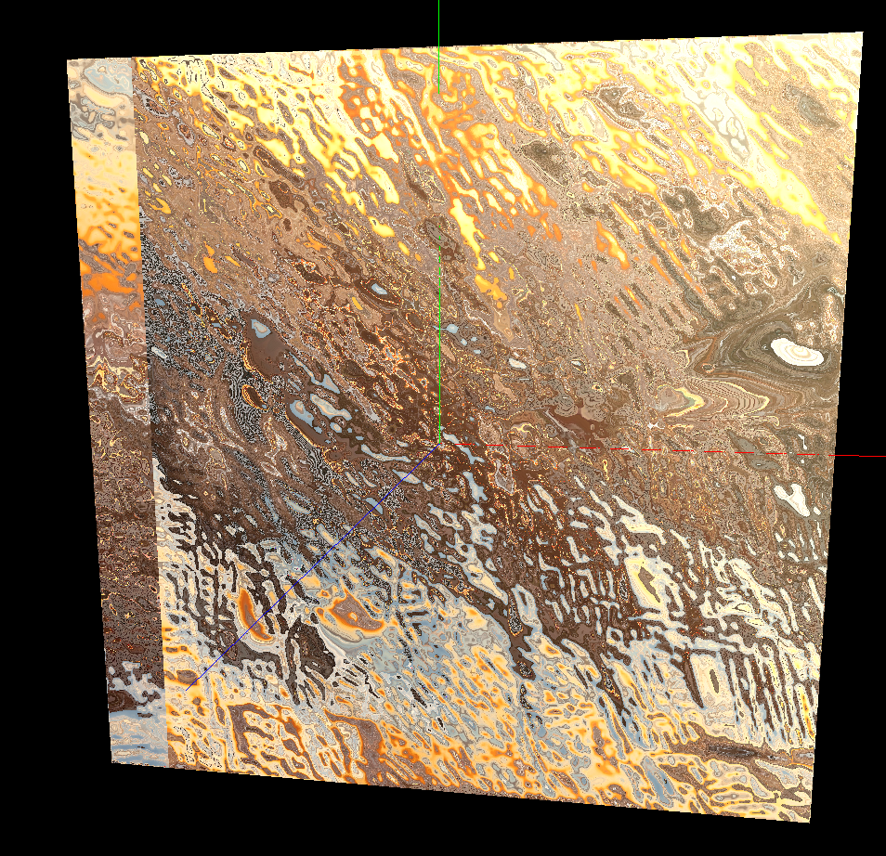
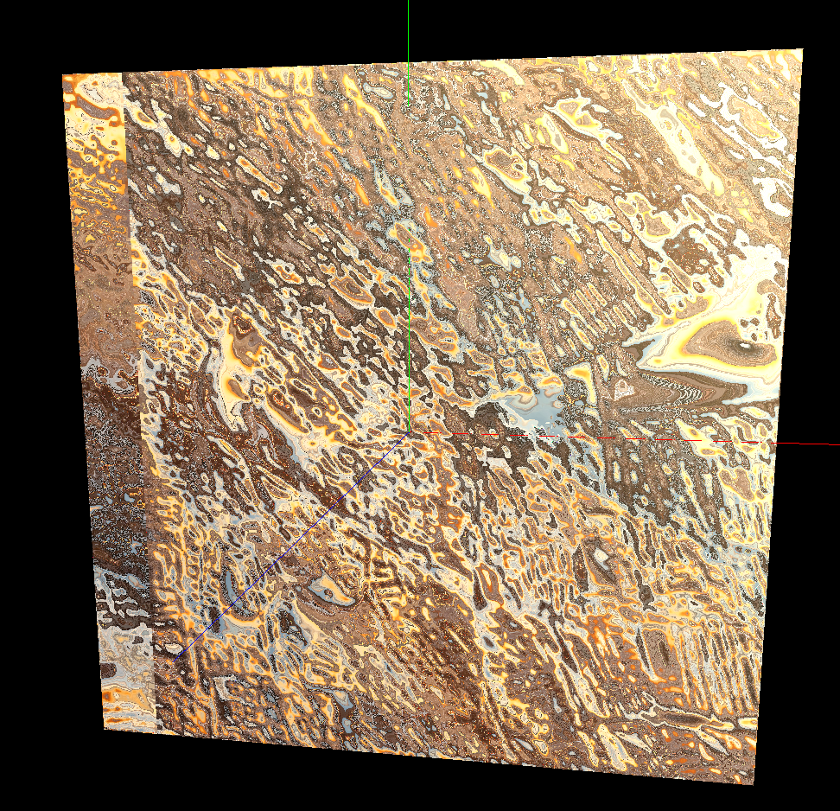
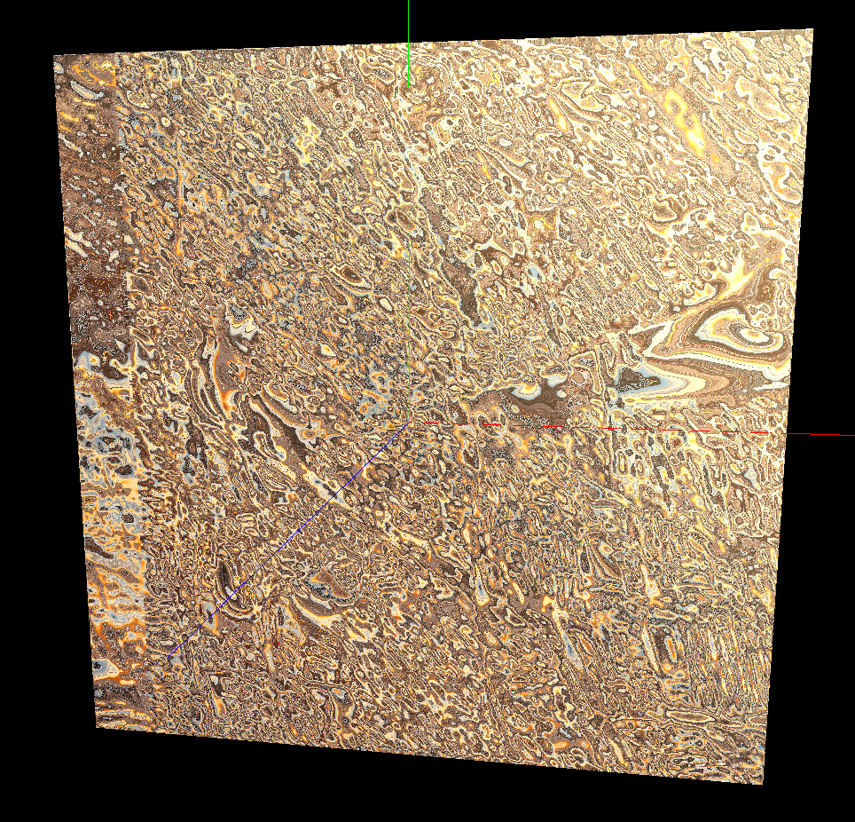
Results: Extreme Displacement Functions
x1
x2
x5
Using only the normalized noise vector, we can preserve detail of the Noise map, up to certain point.
…But, the original landscape is ruined
Notes:
Normalized vector x 1/2/5

Slide 5
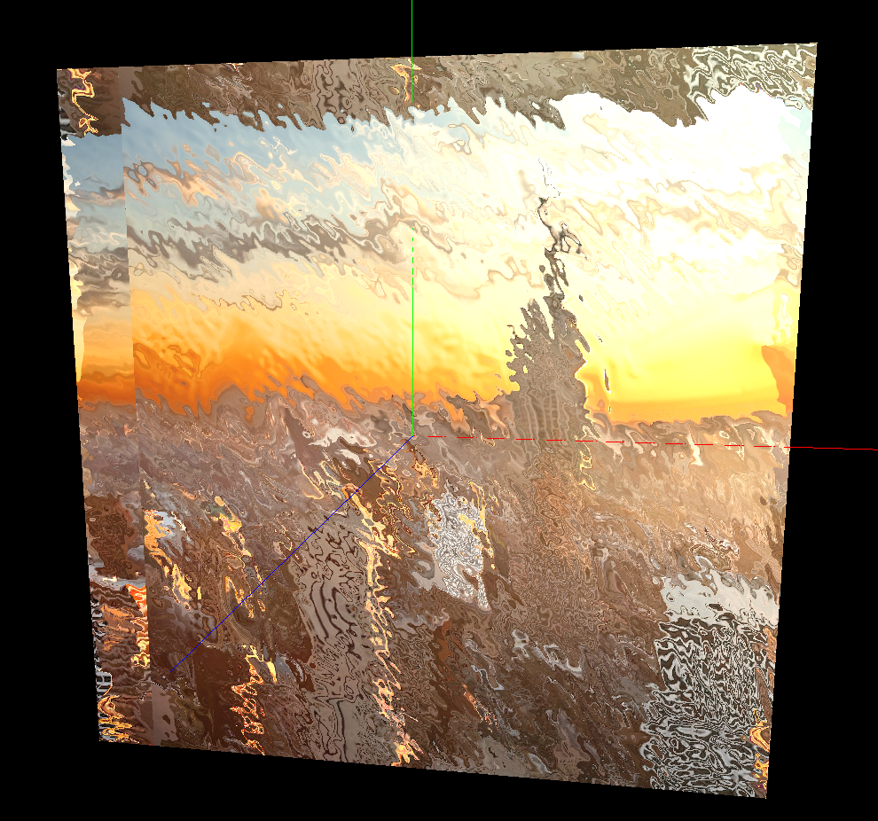
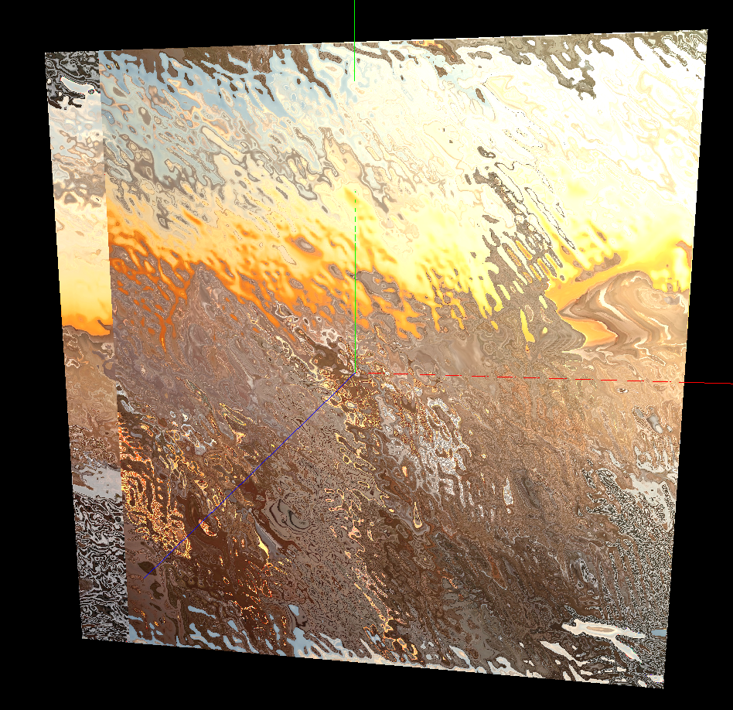
Results: Balancing out noise
noiseVec * .5
(noiseVec * 3.0 – 2.0) * .1
Must compensate how much detail of the noise map with how much detail of landscape.
When combined with specular light…looks like rippled water with a reflection of the landscape...nice!
Notes:
After trying many equations for the noiseVec…

